Slide 1
ne_turb_add_2_wtiv
Turbine Upsizing Scenario
Add 2 WTIV

Slide 2
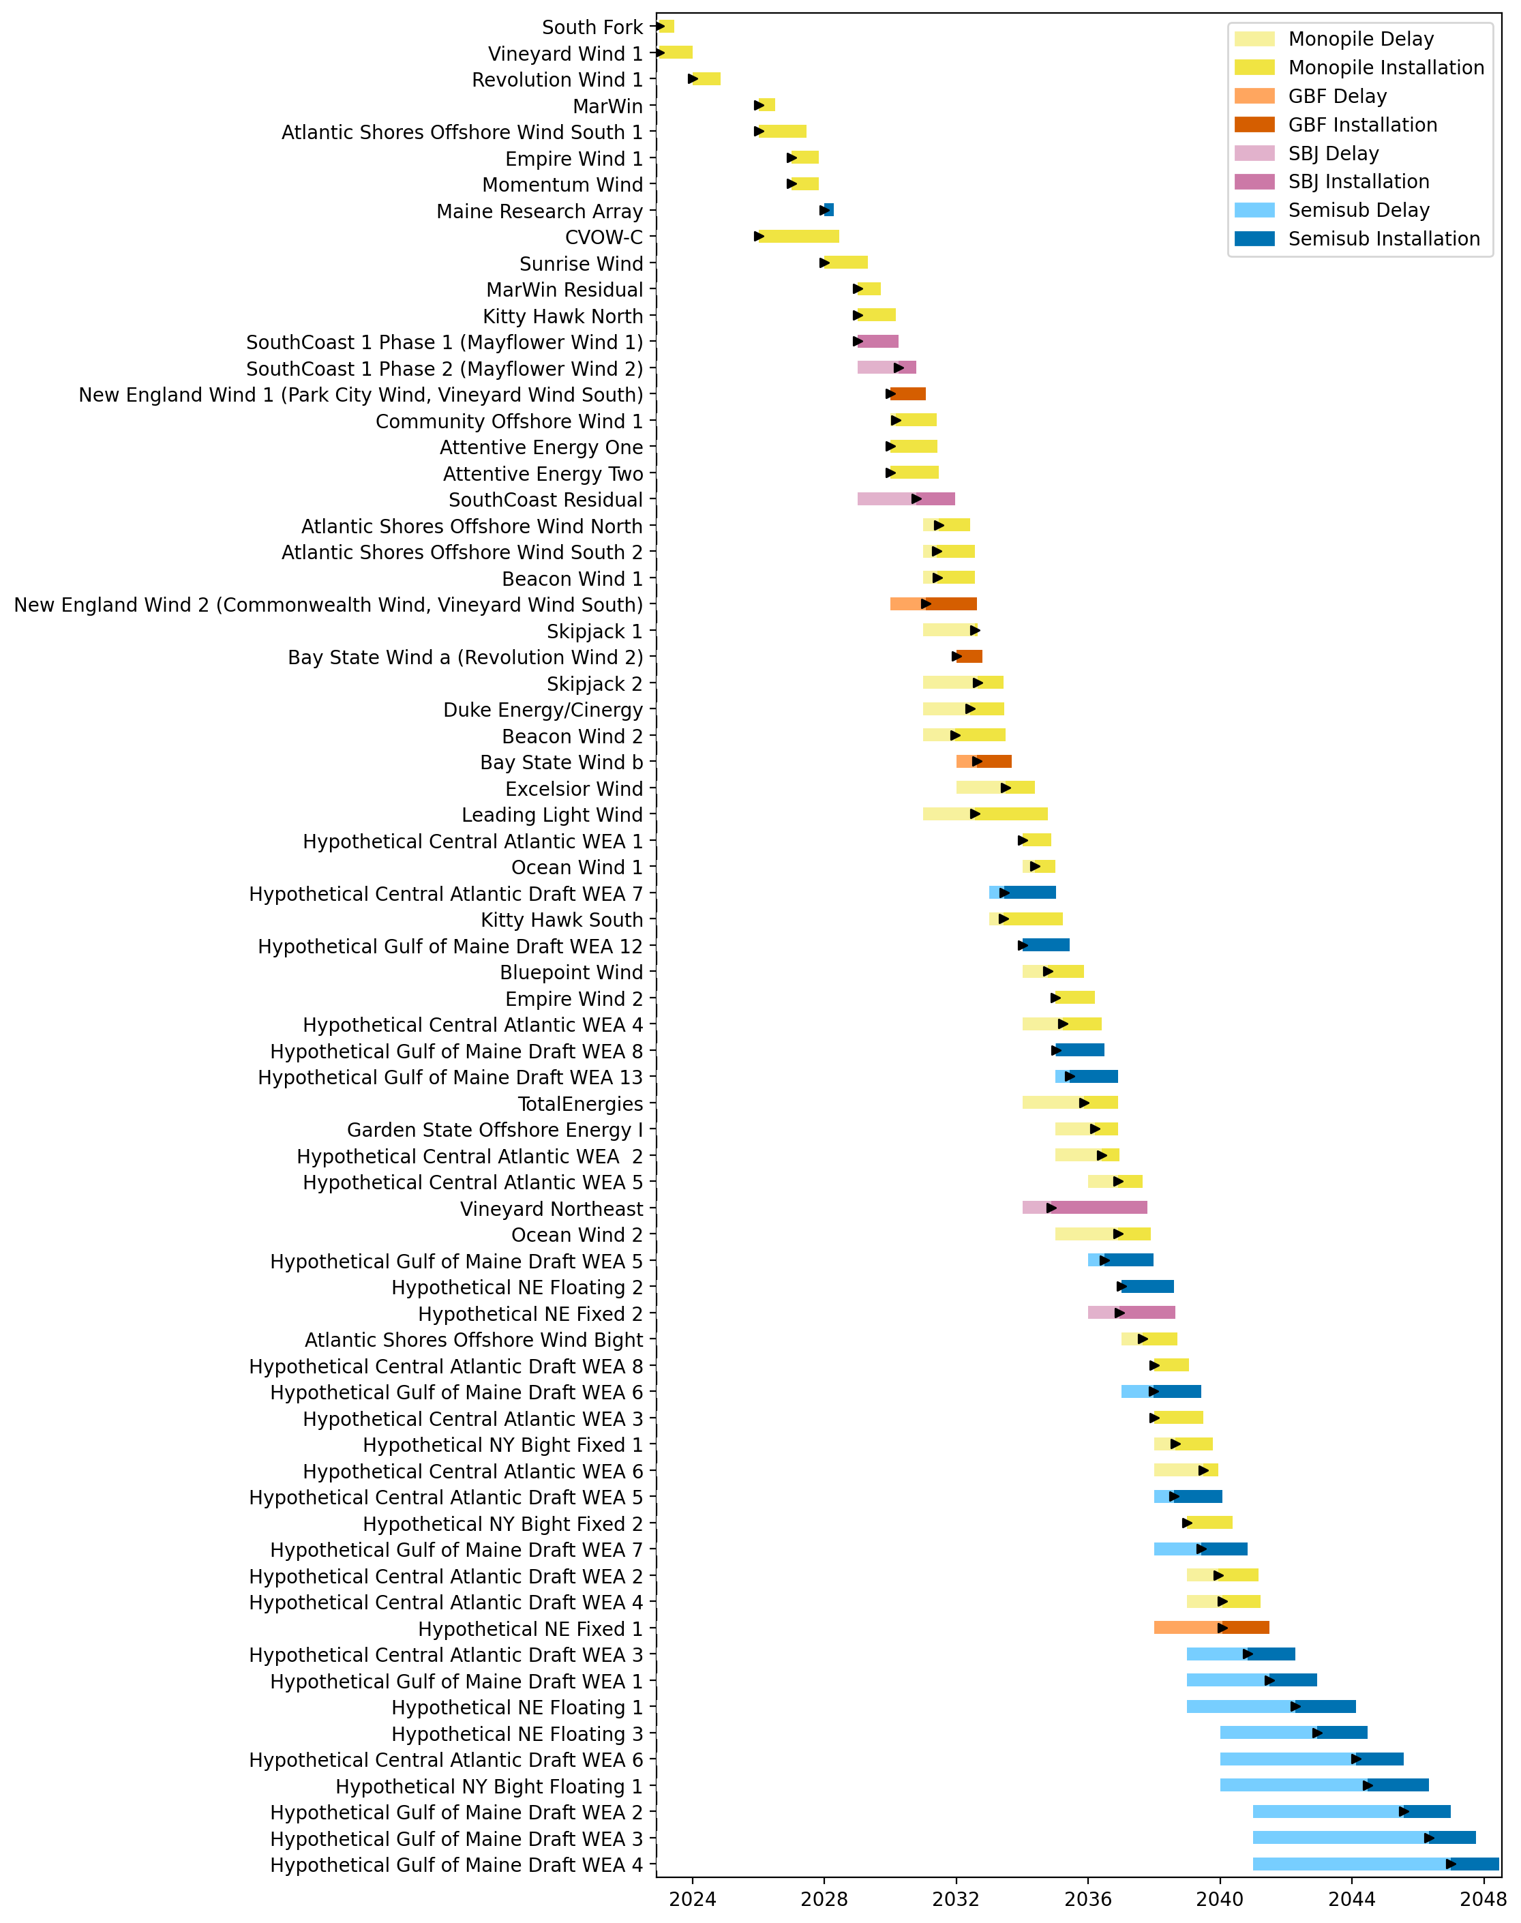
Full Gantt

Slide 3
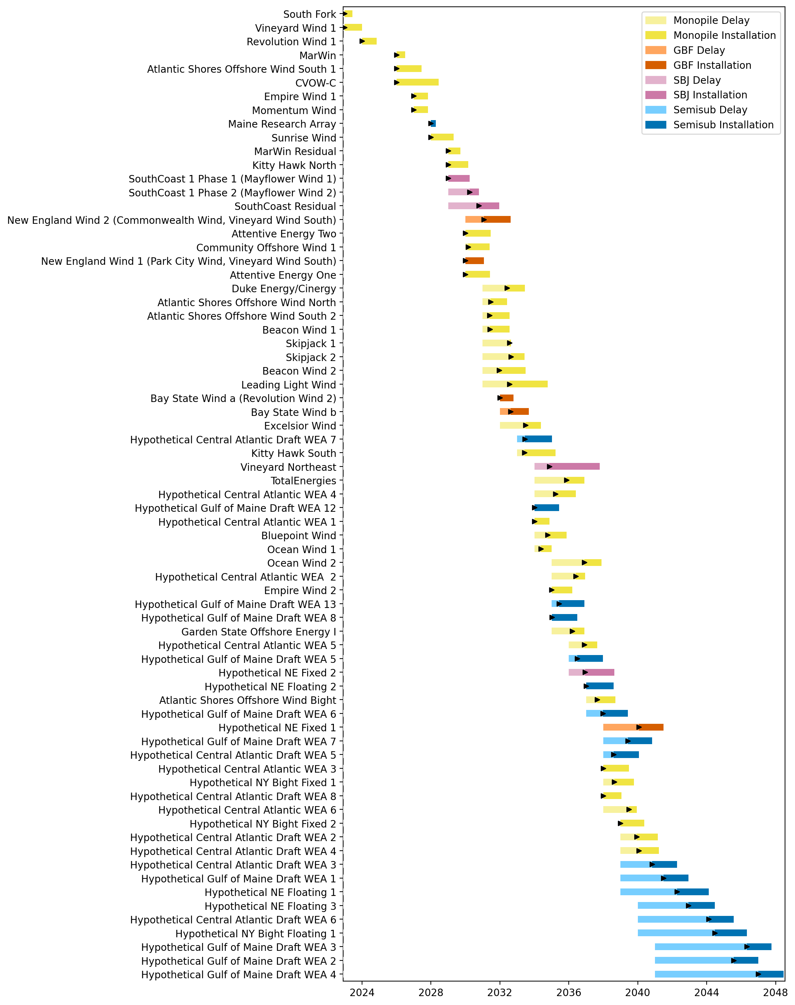
Sorted Full Gantt

Slide 4
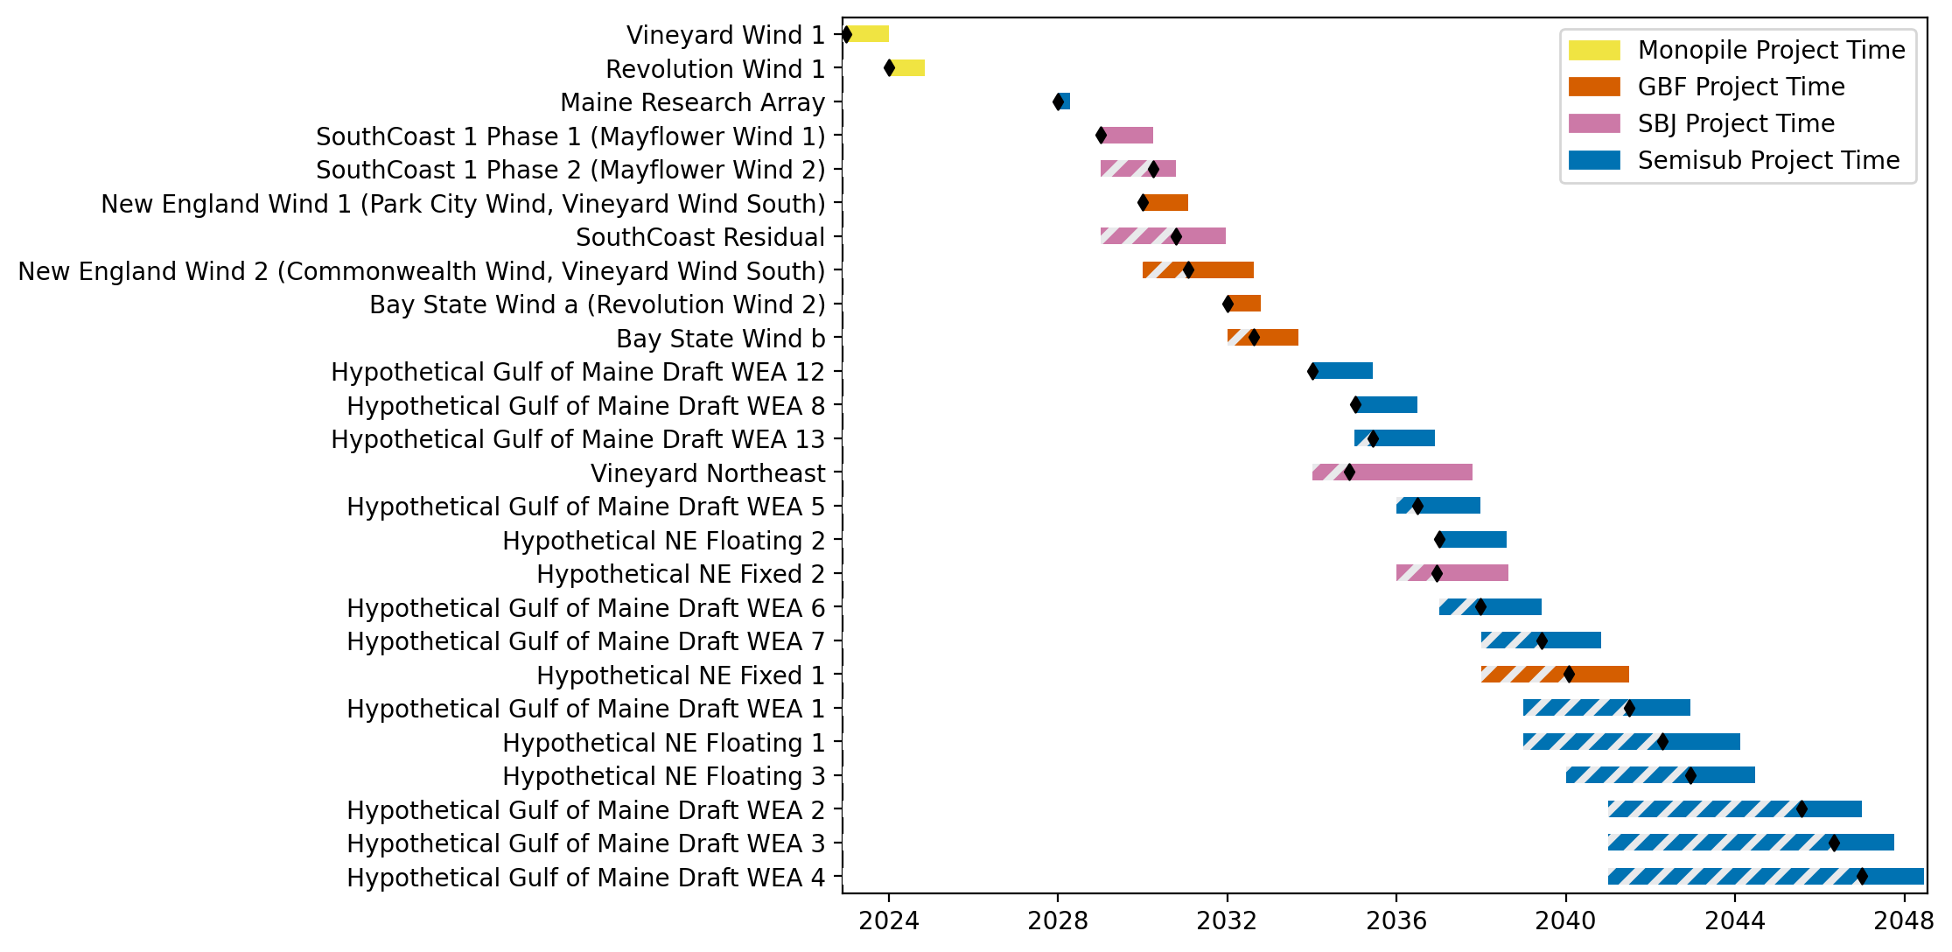
New England Gantt

Slide 5
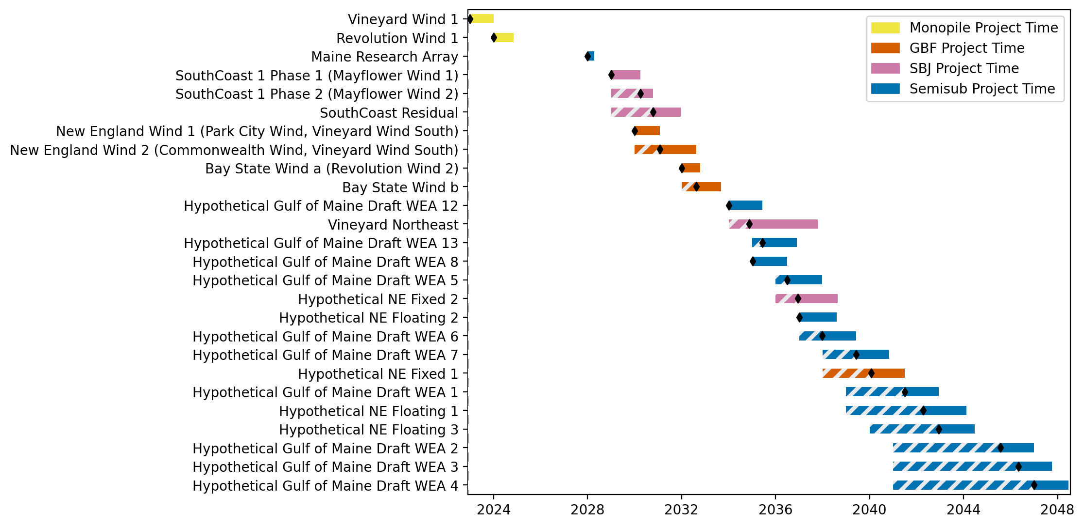
Sorted New England Gantt

Slide 6
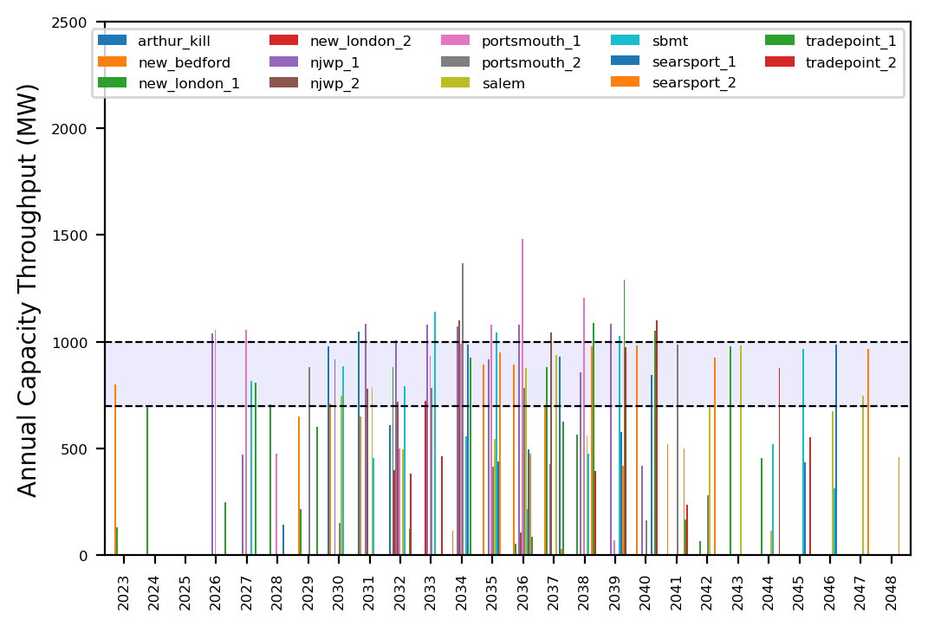
Port Throughput

Slide 7
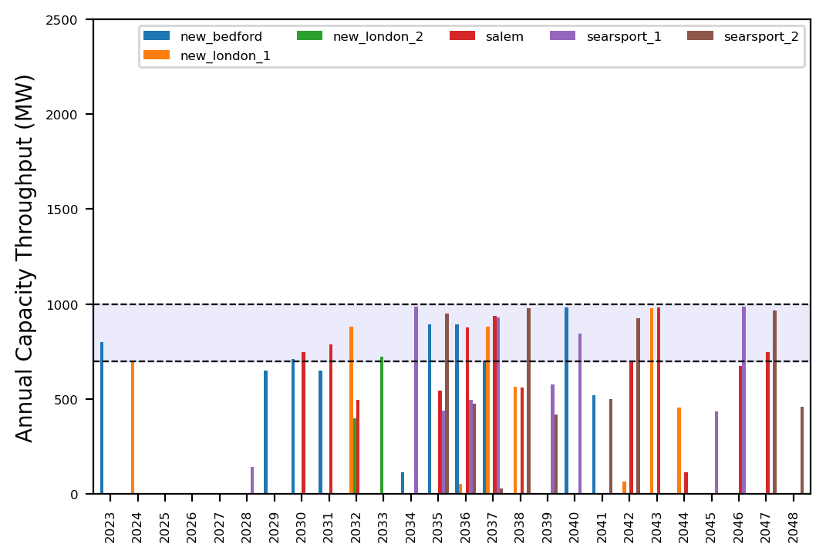
Port Throughput

Slide 8
ne_turb_add_3_wtiv
Turbine Upsizing Scenario
Add 3 WTIV

Slide 9

Full Gantt

Slide 10
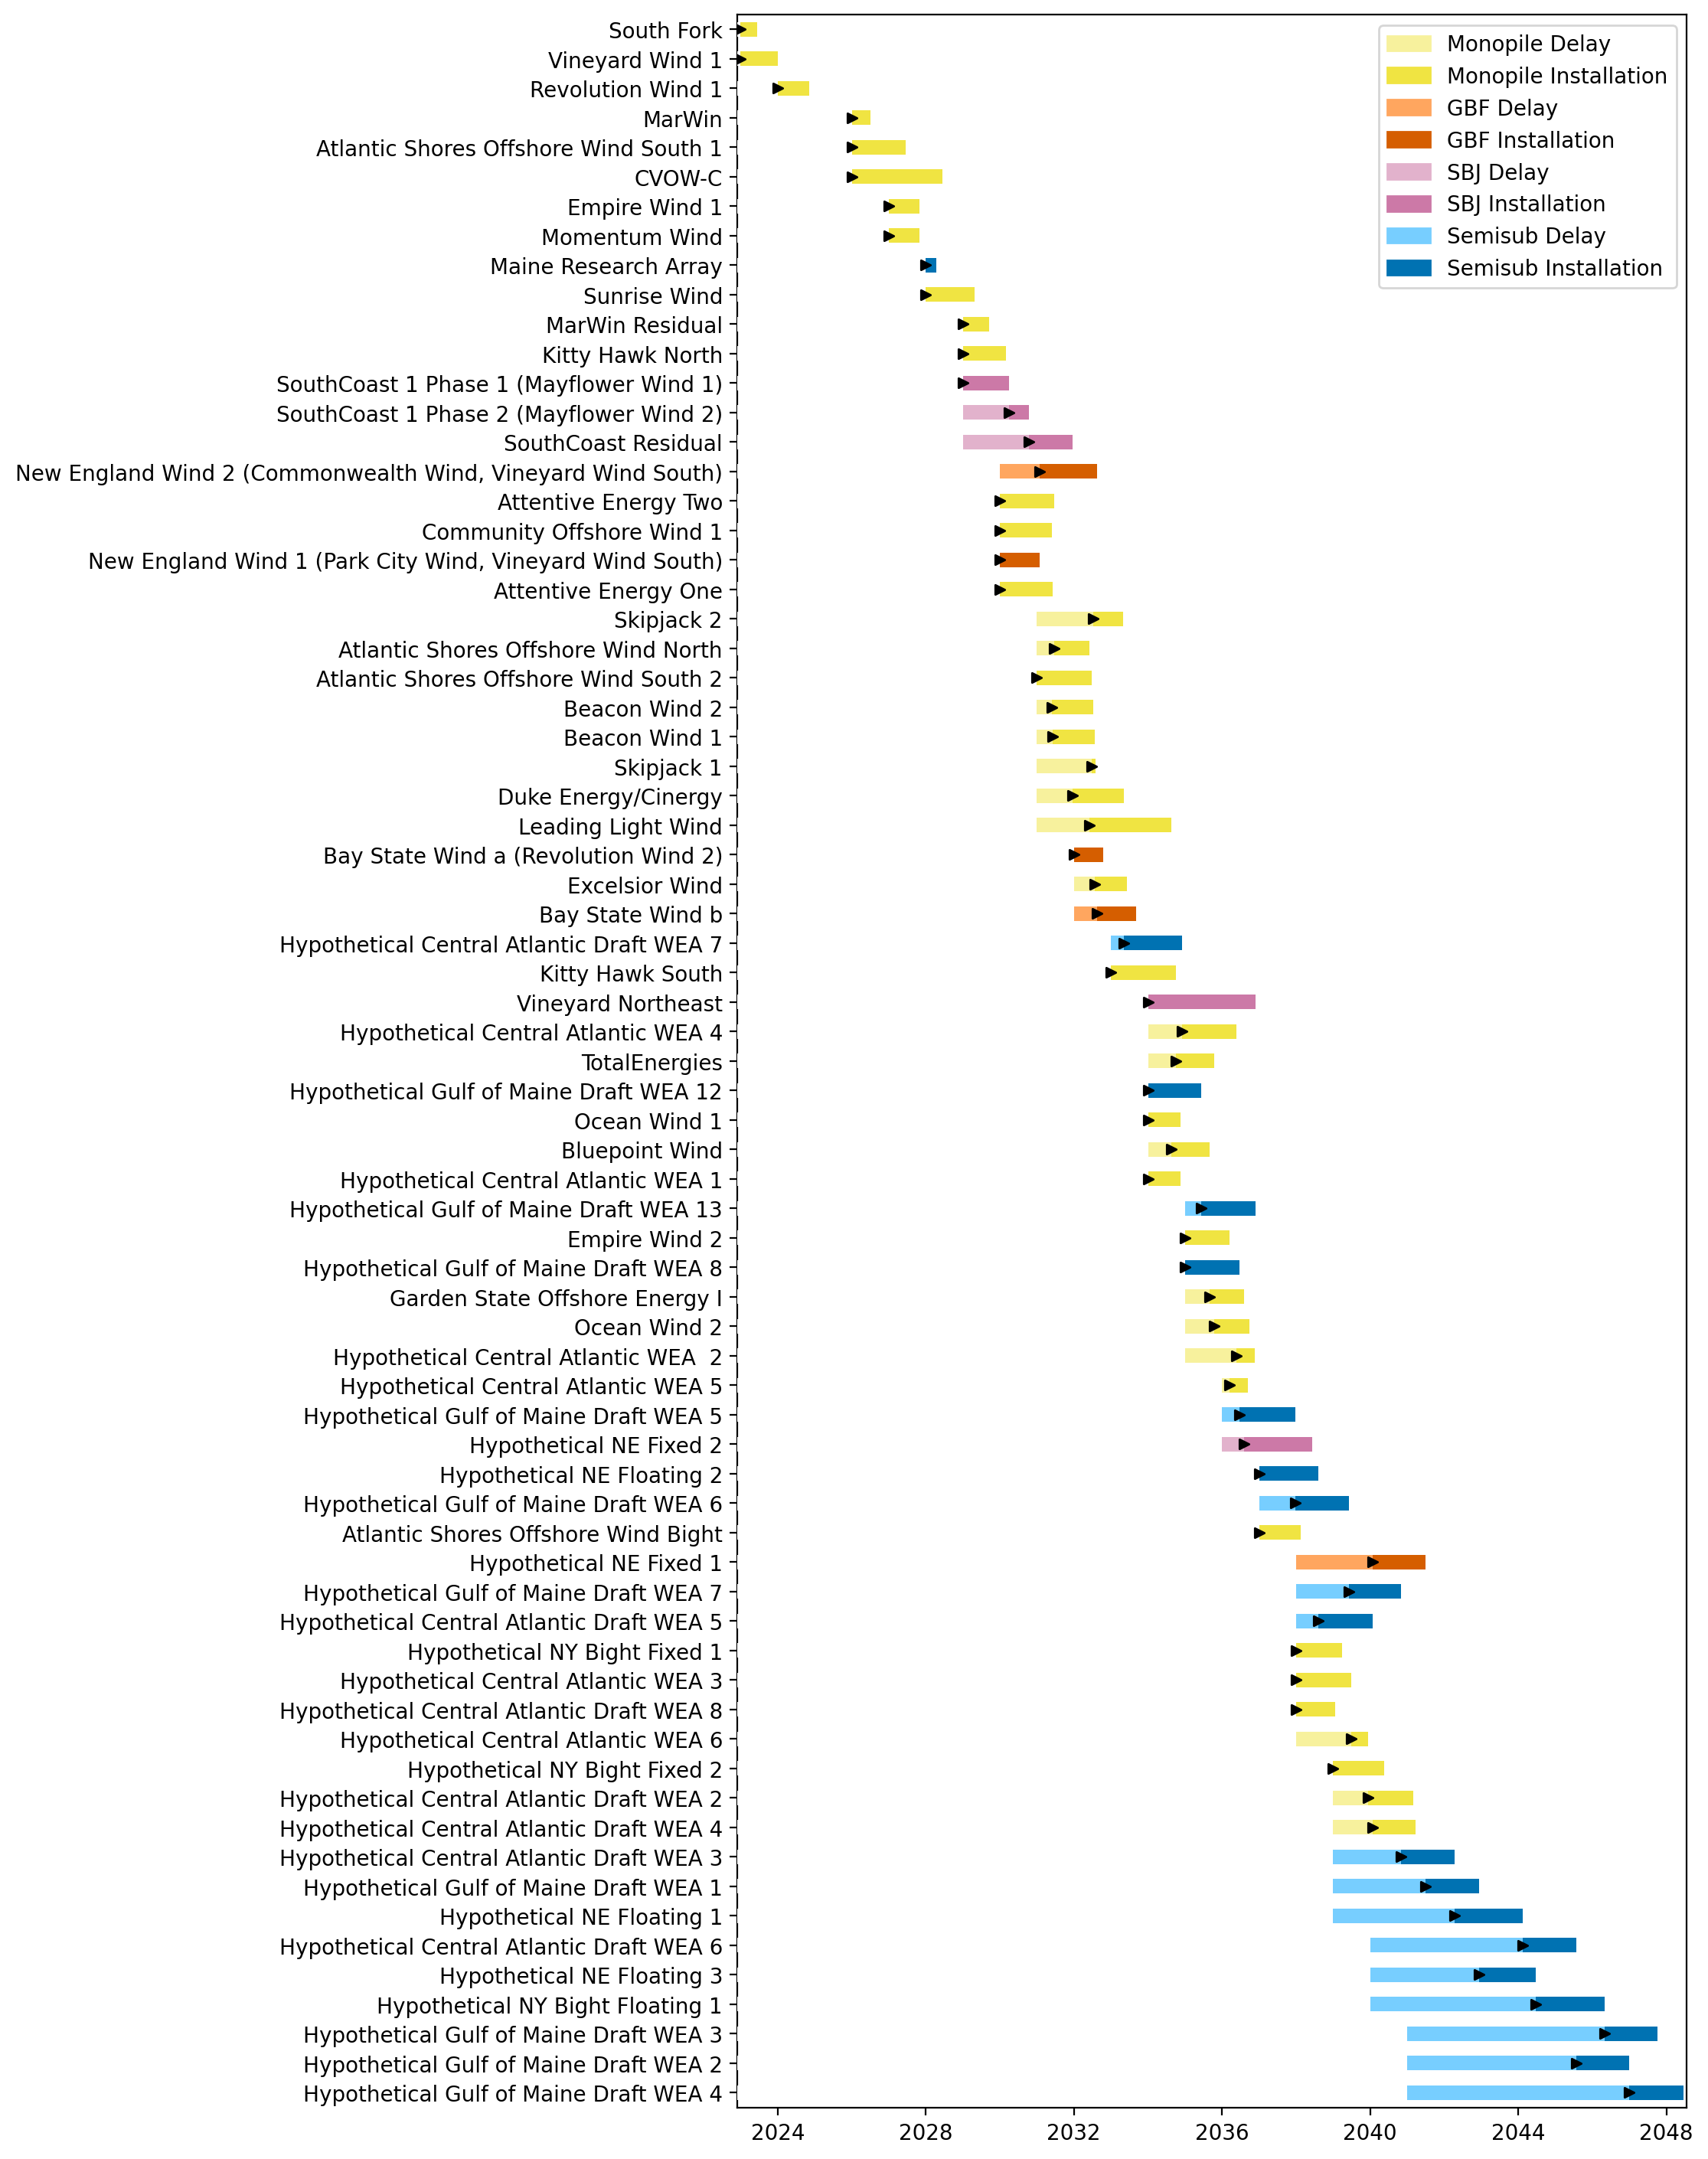
Sorted Full Gantt

Slide 11
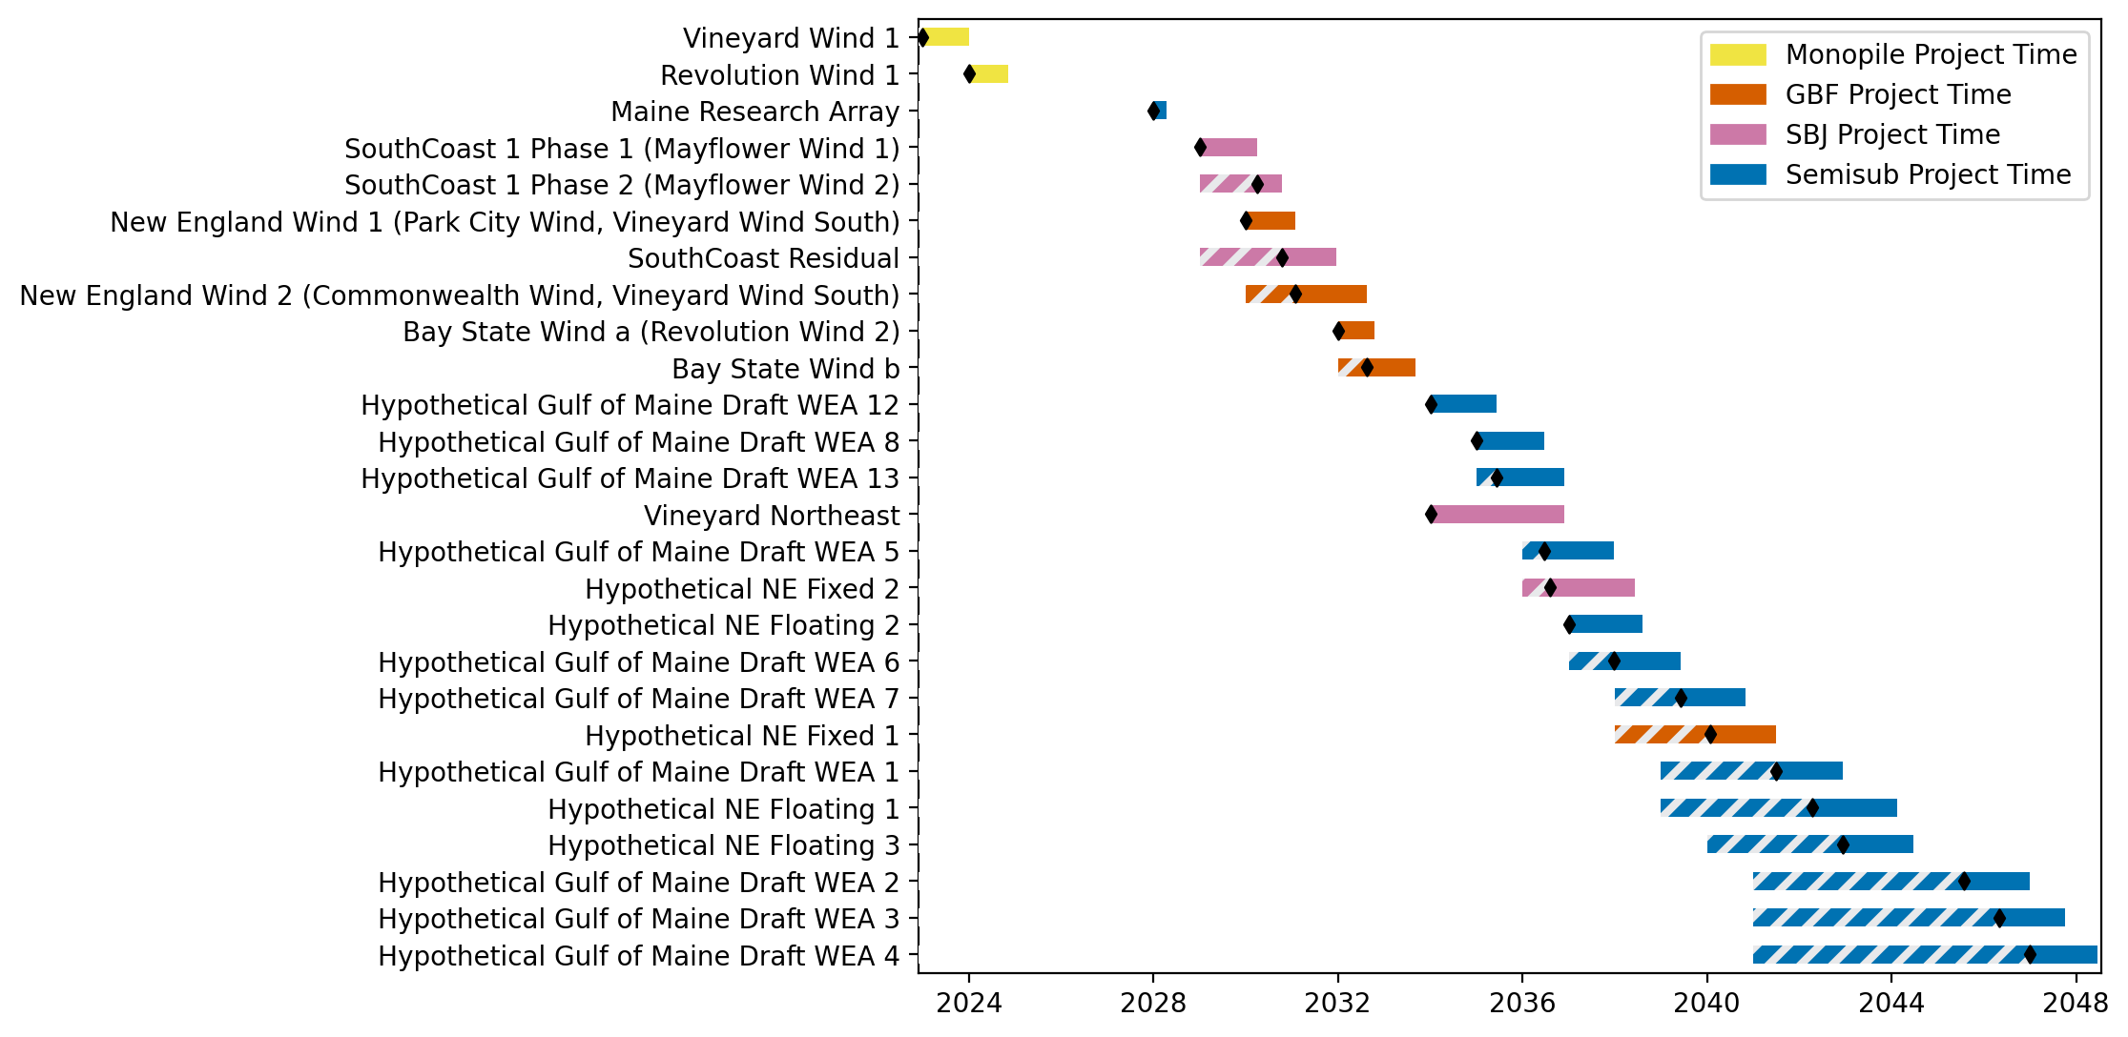
New England Gantt

Slide 12

Sorted New England Gantt

Slide 13
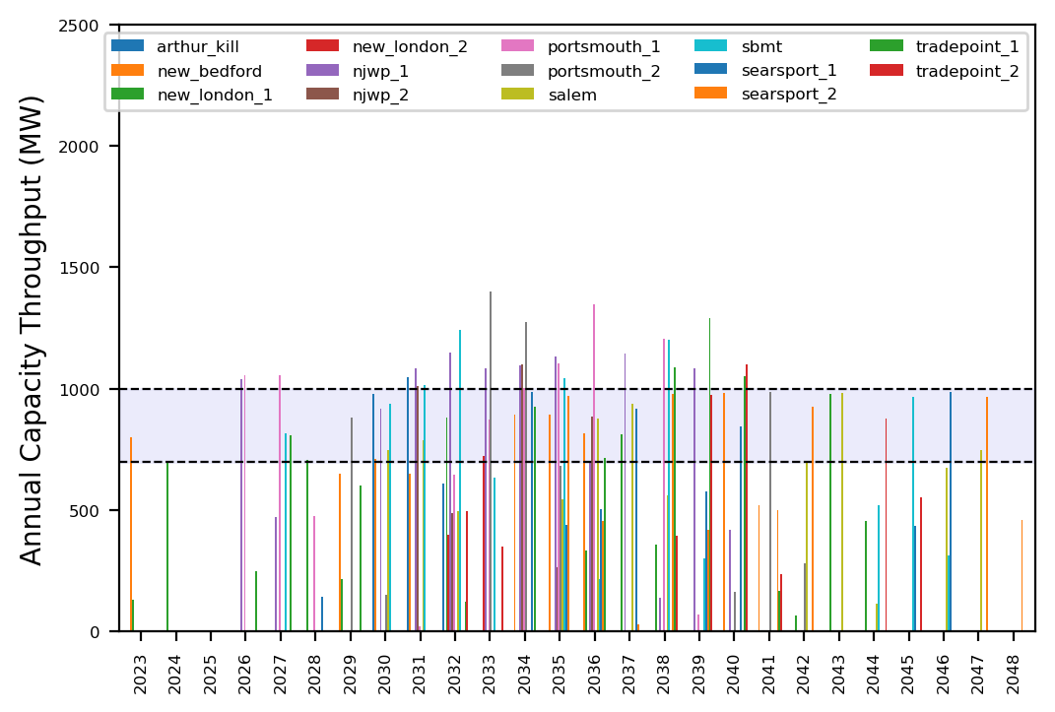
Port Throughput

Slide 14
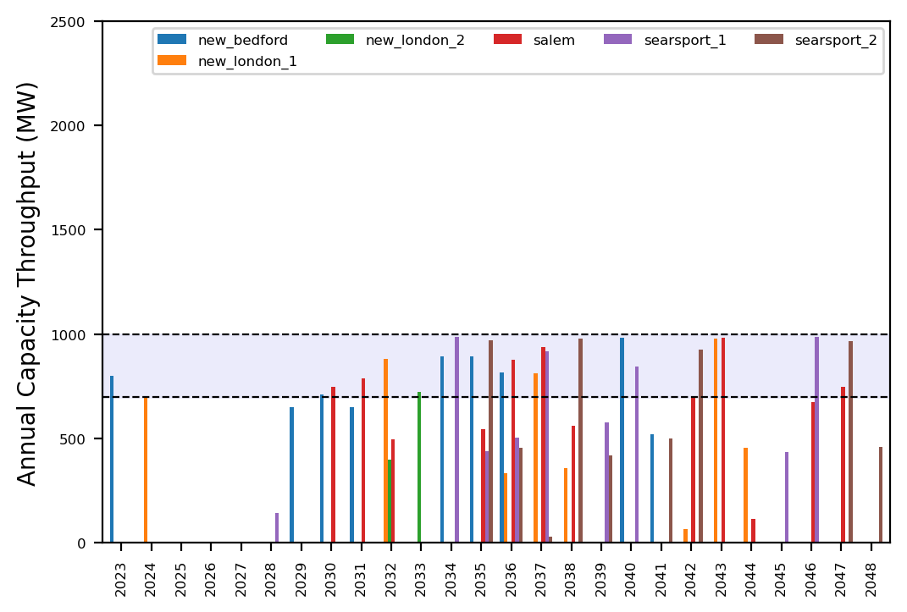
Port Throughput

Slide 15
ne_turb_add_4_wtiv
Turbine Upsizing Scenario
Add 4 WTIV

Slide 16
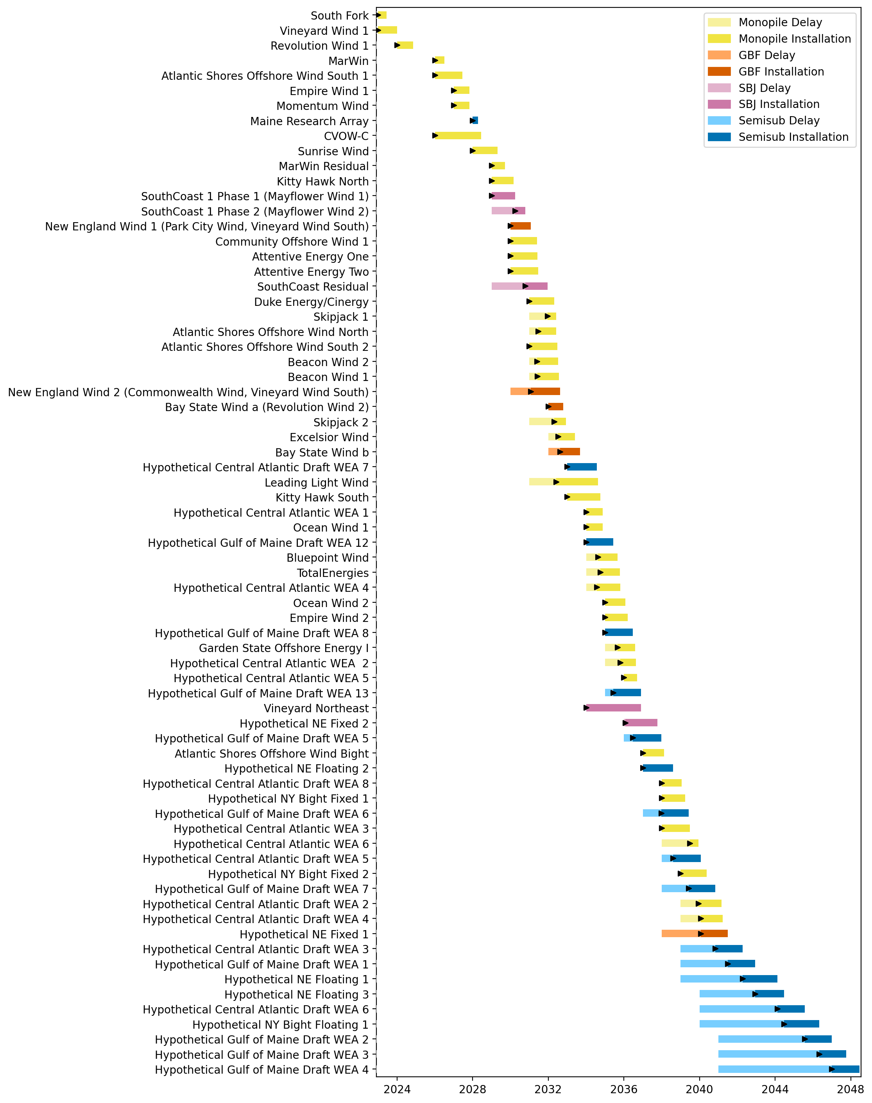
Full Gantt

Slide 17

Sorted Full Gantt

Slide 18
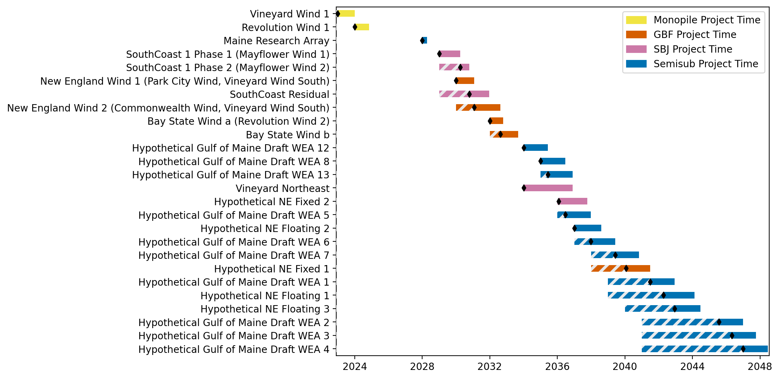
New England Gantt

Slide 19
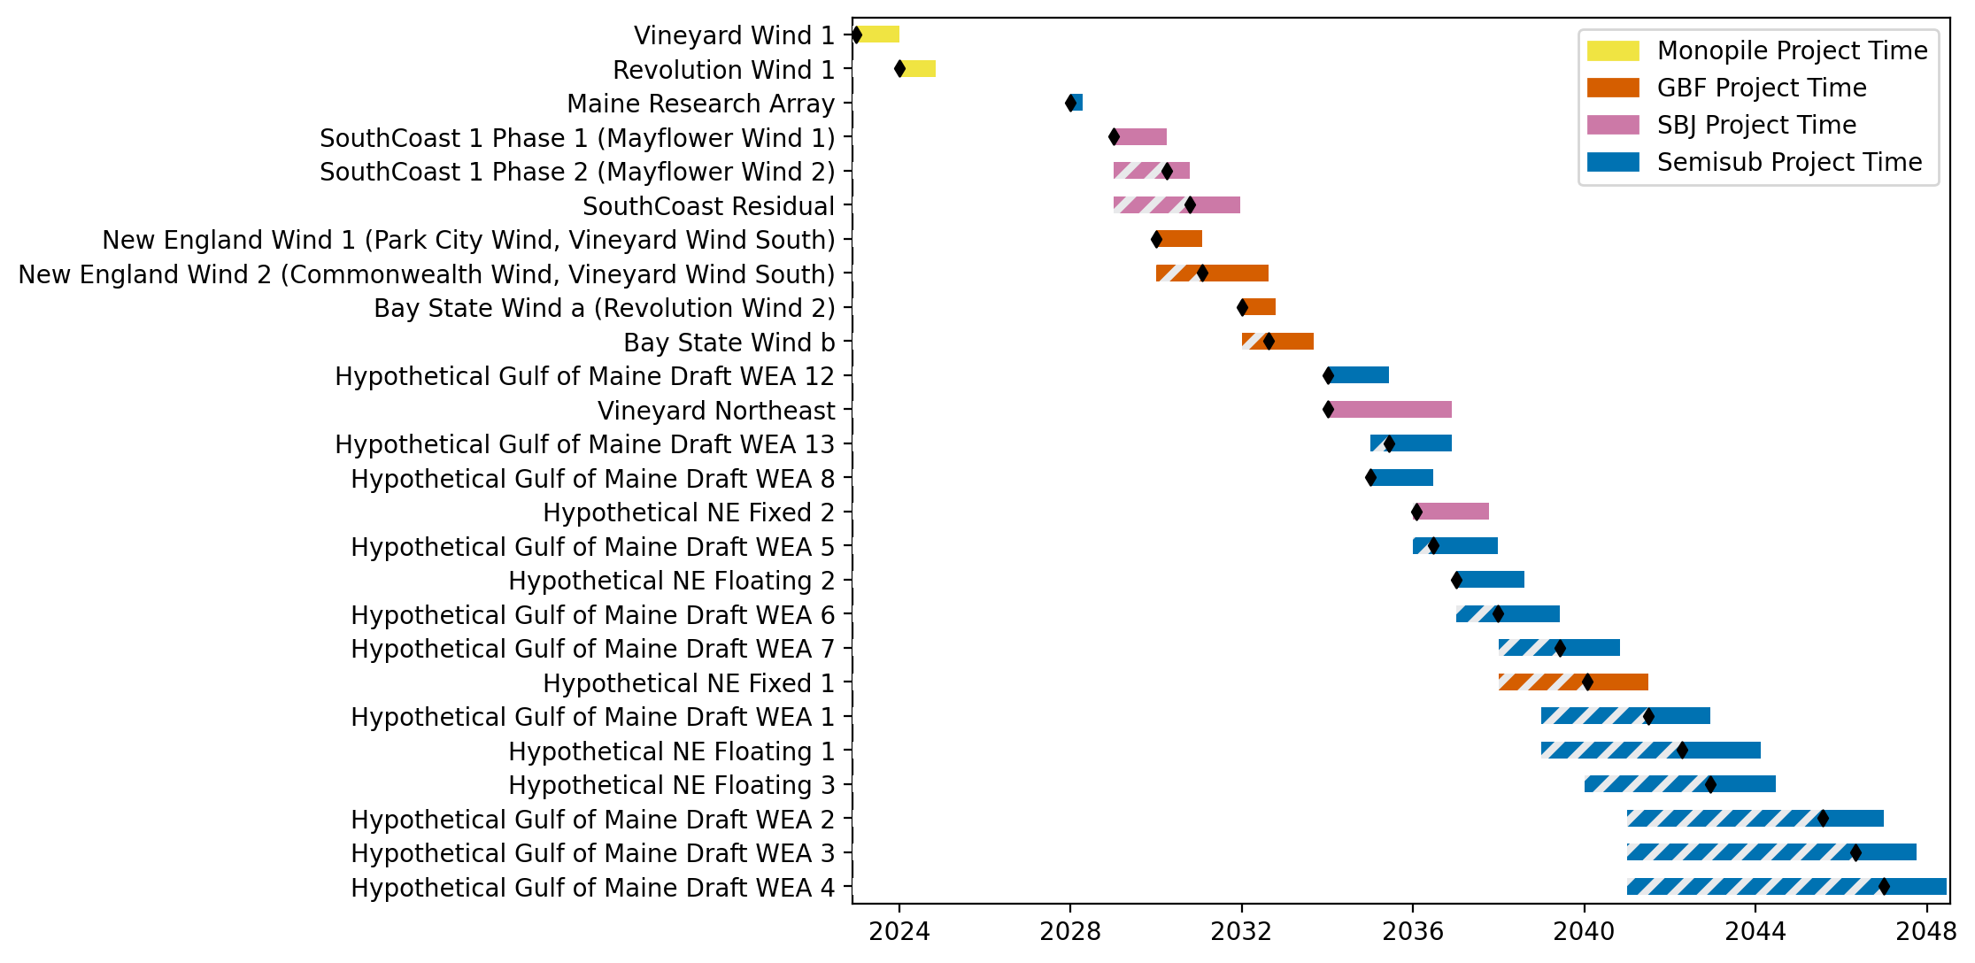
Sorted New England Gantt

Slide 20
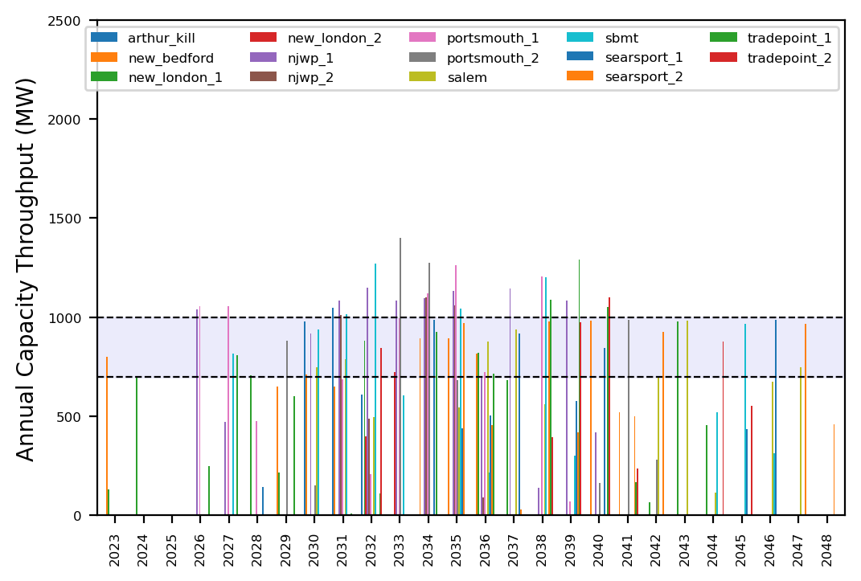
Port Throughput

Slide 21

Port Throughput

Slide 22
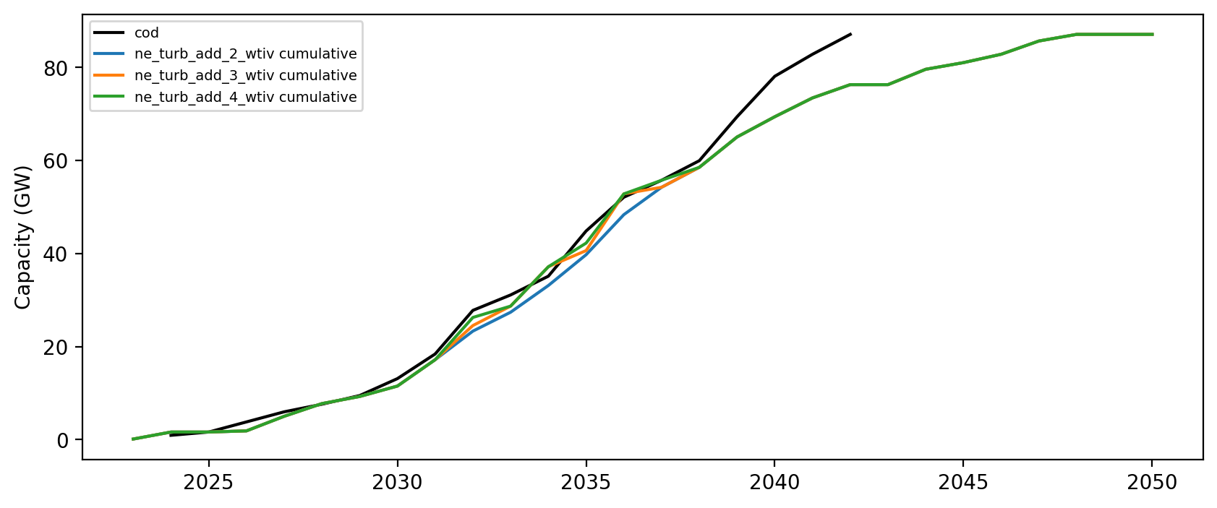
Installed Capacity

